Slide 1
Office 365 Development

Slide 2
Deep Dive into SharePoint-Hosted Apps

Slide 3

Agenda
SharePoint Hosted Apps
Introduction
Programming in JavaScript
App Parts
UI Custom Actions
SharePoint Provider Hosted Apps
Introduction
Programming in C#
Programming in JavaScript
Chrome Control
Remote Event Receivers

Slide 4
Introduction

Slide 5
Architecture (SharePoint-Hosted Apps [OnPrem+365])
SharePoint (OnPrem/365)
Host Web
SubSPWeb+App Web
-SubWeb under HostWeb
-Separate Domain
-Created during App Installation
ACS
ACS (Access Control Service):
- OnPrem: SharePoint
- 365: AACS
Notes:
App Web is a sub web under the host web
App web is a separate domain
App web is created during app installation process
App web contains pages and other declarative SharePoint artifacts
App web is limited to JavaScript
App web can access host web as long as it has appropriate permissions
May call to other cross-domain resources using appropriate techniques such as cross-origin resource sharing (CORS) or a web proxy

Slide 6
The App Web
App Web is isolated in its own domain
Enforces “Same Origin” policy for the app
Allows for authentication and authorization when calls are made to the host web
Each app has it’s own unique URL
Tenancy – your organization’s tenancy
App Unique Identifier – unique generated identifier for the app instance
Hosting Domain – defined for each farm
App Name – contained in the app manifest
https://[tenancy]-[appuid].[hostingdomain]/[appname]
Notes:
Each app web is isolated in a unique domain

Slide 7
App Start Page
Specified in App Manifest
~appWebUrl/Pages/Default.aspx?{StandardTokens}
Utilizes Tokens for dynamic replacement of parameters
~appWebUrl token representing the URL for the app web of this app instance
{StandardTokens} passes key query string parameters to the app on launch
Parameter | Description
SPHostUrl | The URL of the host web
SPAppWebUrl | The URL of the app web
SPLanguage | The language/culture of the host web
SPClientTag | The client cache control number for the current website
SPProductNumber | The full build version number of the SharePoint farm
Notes:
{StandardTokens} combines five other tokens. It initially resolves to SPHostUrl={HostUrl}&SPAppWebUrl={AppWebUrl}&SPLanguage={Language}&SPClientTag={ClientTag}&SPProductNumber={ProductNumber}. Then each of these tokens resolves. If there is no app web, the portion &SPAppWebUrl={AppWebUrl} is not present.

Slide 8
App Permissions
Utilizes “Internal” (SharePoint) Authentication
App permissions are the lesser of user and app permissions to the given resource
Notes:
No Oauth tokens required

Slide 9
App Shapes
Full Page
Required for all apps
Experienced when an app is launched from the contents page
App Part
Optional
Allows an app to be hosted in an IFrame on the host web
UI Custom Action
Optional
Allows an app to be launched from the ribbon or Edit Control Block(ECB)
Notes:
These are the different experiences
We’ll cover these in detail as we go along

Slide 10
Creating SharePoint-Hosted Apps
Pages
ASPX
HTML
Authorization
Internal SharePoint
Programmability
JavaScript (REST or CSOM)
JavaScript Cross-Domain Library
Web Proxy
Notes:
SharePoint-Hosted apps can be built on ASPX or HTML pages
The authorization is always done with “Internal” auth, meaning no OAuth tokens
Programmability is always JavaScript
You can use CSOM, REST, cross-domain library, or web proxy in your solution

Slide 11
demo
Creating a SharePoint-Hosted App

Slide 12
Programming in JavaScript

Slide 13
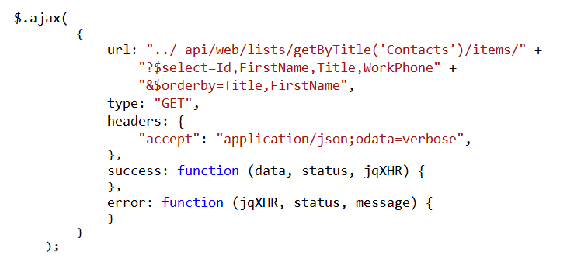
Using the REST API
Notes:
This is a READ sample. The other CRUD operations follow.

Slide 14
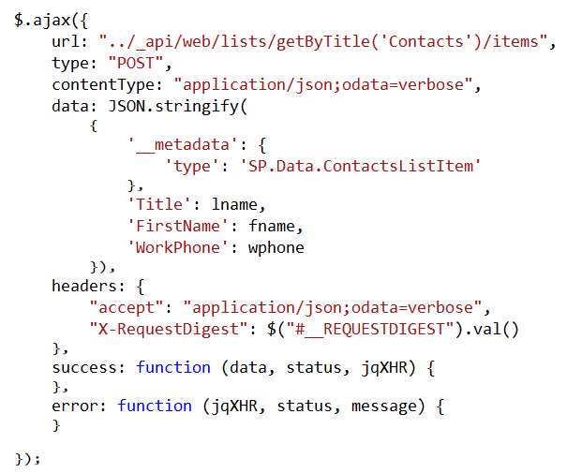
Create List Items

Slide 15
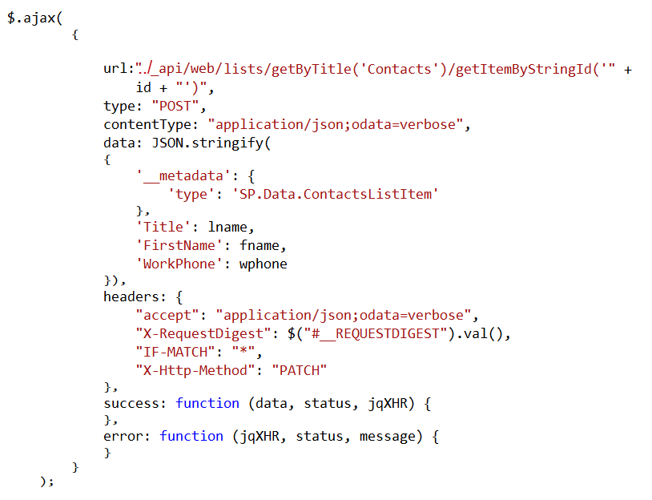
Update List Items

Slide 16
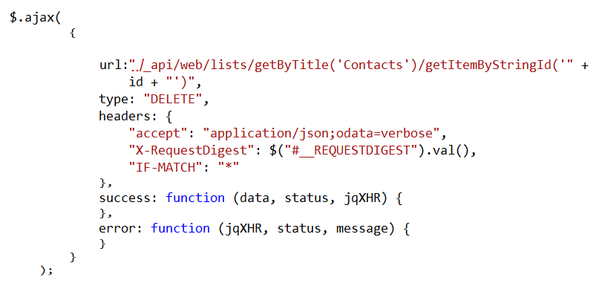
Delete List Items

Slide 17
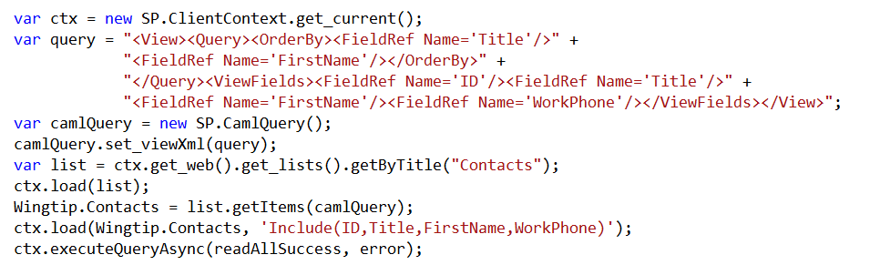
Using the CSOM API
Notes:
This is a READ sample. The other CRUD operations follow.

Slide 18
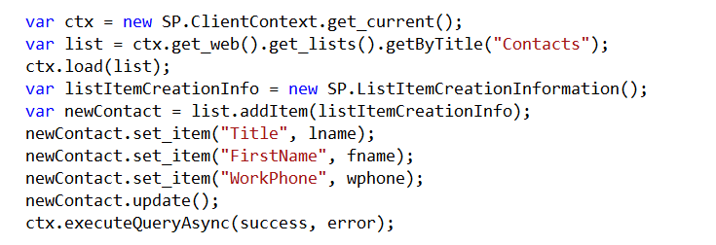
Create List Items

Slide 19
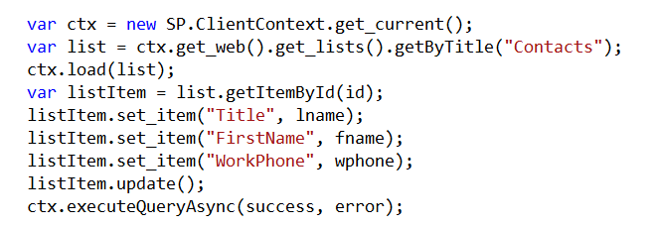
Update List Items

Slide 20
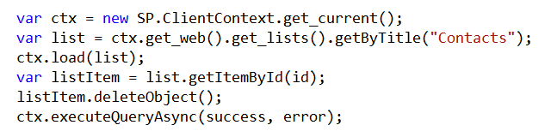
Delete List Items

Slide 21

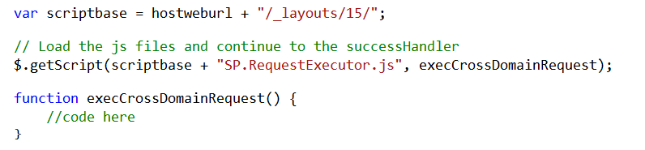
Cross Domain Library
Same-domain policy prevents JavaScript from making direct calls to the host web
SP.RequestExecutor.js located in LAYOUTS directory
Option 1: Reference directly
Option 2: Load dynamically
Notes:
Makes it possible to call the host web from JavaScript in the app web

Slide 22
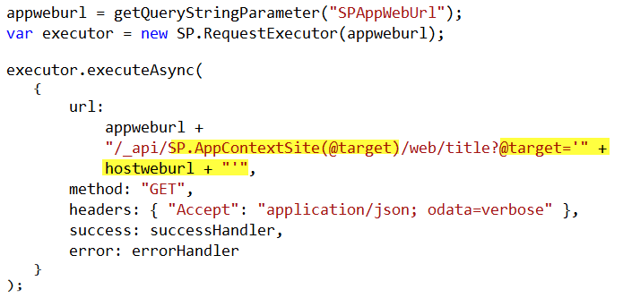
Cross-Domain REST Calls
Notes:
When calling the host web, you must switch the context

Slide 23
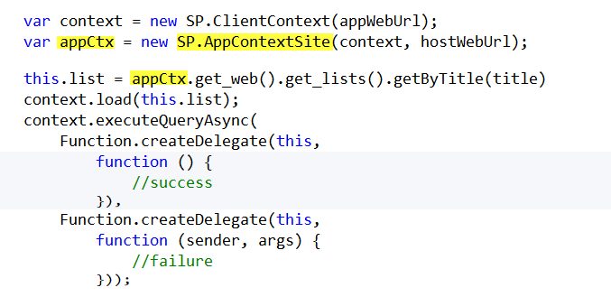
Cross-Domain CSOM Calls
Notes:
When calling the host web, you must switch the context

Slide 24
App Parts

Slide 25
App Parts
Allow functionality to be added to pages in the host web in a manner similar to web parts
App part is rendered through an IFrame on the host web
App part is defined using the Client Web Part
Supported in both SharePoint-hosted and Provider-hosted apps

Slide 26
Client Web Part
References the page that should display in the Iframe
Supports the creation of properties that appear in the property pane when the app part is added to a page in the host web

Slide 27
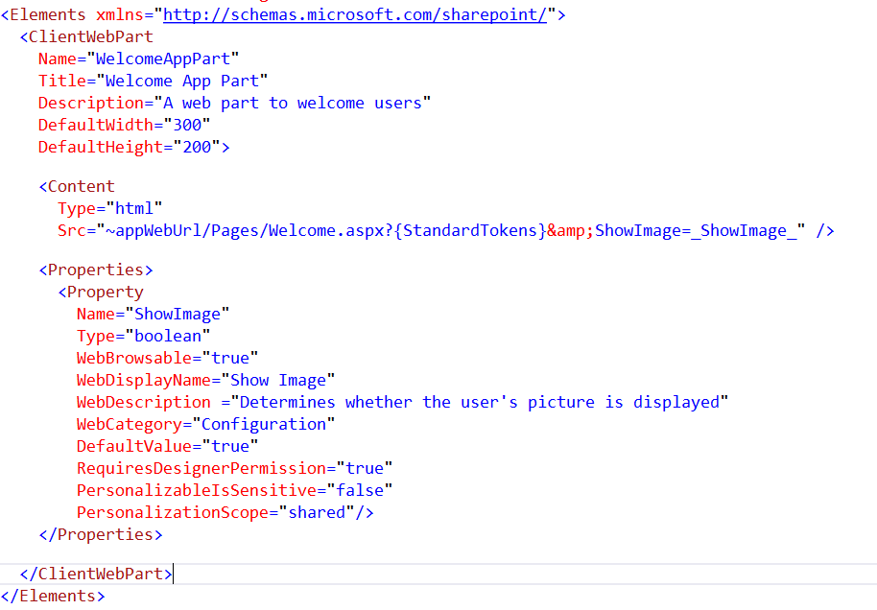
Client Web Part CAML

Slide 28
UI Custom Actions

Slide 29
UI Custom Actions
Can extend the Ribbon or Edit Control Block (ECB)
Launches a target page in your app
Supports the addition of tokens to pass information to the app

Slide 30
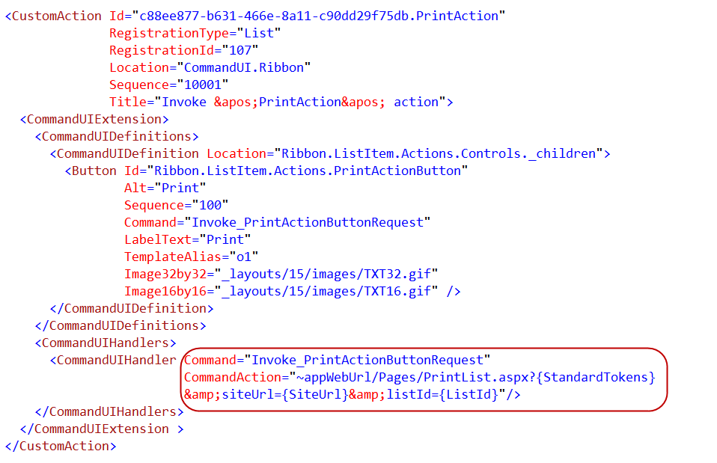
Custom Action CAML

Slide 31
Office 365 Development

Slide 32
Deep Dive into Provider Hosted Apps

Slide 33
Introduction

Slide 34
Architecture (Provider-Hosted Apps [OnPrem+365])
SharePoint (OnPrem/365)
Host Web
SubSPWeb
-SubWeb under HostWeb
-Separate Domain
-Created during App Installation
ACS
Provider
ACS (Access Control Service):
- S2S
- AACS
App-Web
Notes:
App Web is a sub web under the host web
App web is a separate domain
App web is created during app installation process
App web contains pages and other declarative SharePoint artifacts
App web is limited to JavaScript
App web can access host web as long as it has appropriate permissions
May call to other cross-domain resources using appropriate techniques such as cross-origin resource sharing (CORS) or a web proxy

Slide 35
App Permissions
Remote web always has full rights to app web
App permissions are the lesser of user and app permissions to the given resource
Provider-hosted app can utilize “app-only” permissions to “elevate” privileges.

Slide 36


App-Only Permissions
Considers app permissions only, ignores user
Set AllowAppOnlyPolicy to true in AppManifest
Get an app-only token
Notes:
Provider-hosted apps can use “app only” permissions
Update the App manifest to indicate this is OK
Then you need an app-only token in code

Slide 37
Creating Provider-Hosted Apps
Web Project
ASP.NET Web Forms
MVC 5
(Any technology)
Authorization
Azure Access Control Services
Server-to-Server High Trust
Programmability
SharePointContextProvider class
Managed CSOM or REST
JavaScript Cross-Domain Library
Notes:
Visual Studio supports both ASP.NET Web Forms and MVC5
On-premises authorization uses S2S
Cloud authorization uses OAuth
The SharePointContextProvider simplifies token management
Managed CSOm and RESt can be used directly from the server side
The cross-domain library can be used from JavaScript

Slide 38
demo
Creating a Provider-Hosted App

Slide 39
Programming in C#

Slide 40
SharePointContextProvider Class
Checks for valid Context Token
Redirects if it does not exist
Simplifies the management of context
Provides an ACS or STS context
Context exposes properties for key values like Host Web URL
Simplifies the management of tokens
Context exposes methods to retrieve tokens
Notes:
The SharePointContextProvider simplifies the management of context, and tokens
It uses a cookie to store the CacheKey, and stores the actual token in session state on the server referenced by the cache key
All of this improves performance and makes programming easier

Slide 41
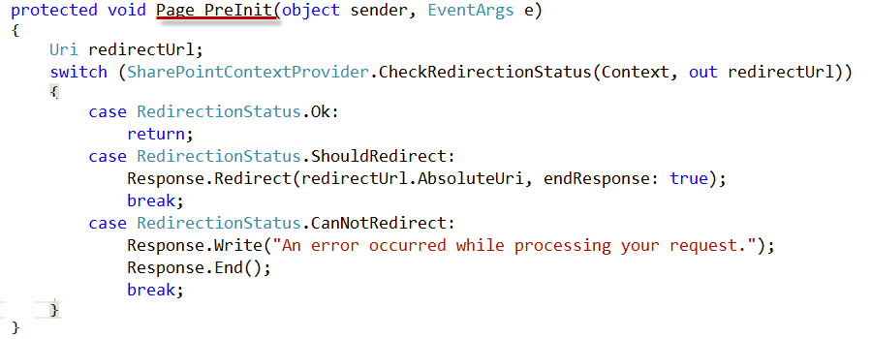
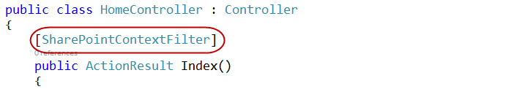
Validating Context Token
Web Forms
MVC 5
Notes:
ASP.NET Web Forms uses the PreInit method to validate the Context Token
Notice how it will redirect if the token is not valid
ASP.NET MVC 5 uses a filter to run essentially the same code
Notice how the filter attribute is applied to the controller

Slide 42
Managing SharePoint Context
SharePointContextProvider GetSharePointContext
Returns SharePointAcsContext in cloud
Returns SharePointHighTrustContext on premises
Properties
SPAppWebUrl
SPClientTag
SPHostUrl
SPLanguage
SPProductNumber
Notes:
SharePointAcsContext and SharePointHightTrustContext both inherit from SharePointContext
This means that the same code works in both cloud and on-premises environments

Slide 43
Managing Security Tokens
CSOM
CreateAppOnlyClientContextForSPAppWeb
CreateAppOnlyClientContextForSPHost
CreateUserClientContextForSPAppWeb
CreateUserClientContextForSPHost
REST
AppOnlyAccessTokenForSPAppWeb
AppOnlyAccessTokenForSPHost
UserAccessTokenForSPAppWeb
UserAccessTokenForSPHost
Notes:
The SharePointContext makes it easy to get the tokens you need

Slide 44
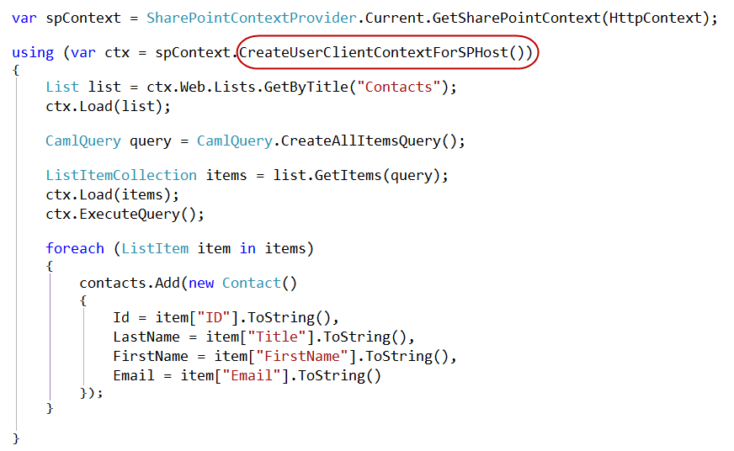
Managed CSOM

Slide 45
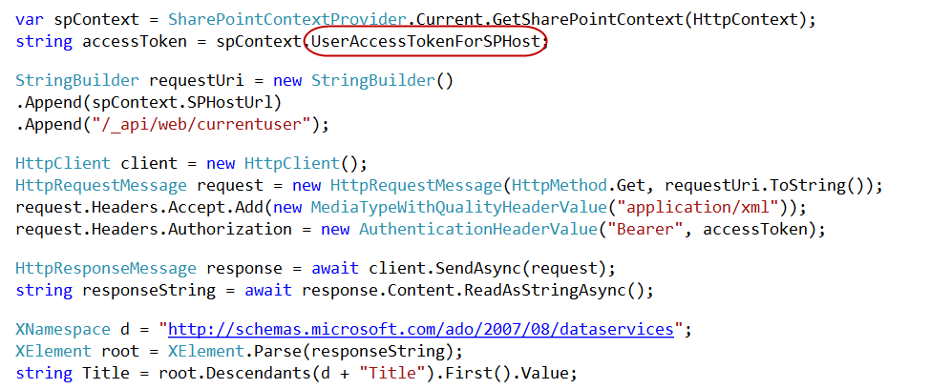
Managed REST

Slide 46
The Chrome Control

Slide 47
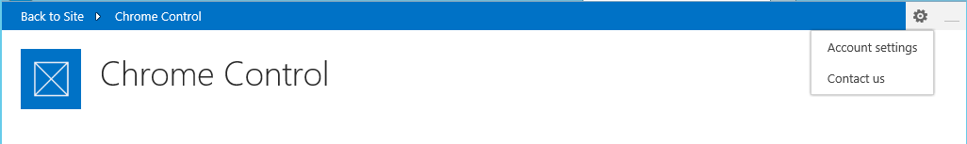
Chrome Control
JavaScript Component for creating basic banner and navigation elements
Notes:
When you create a remote web, it’s nice to have it borrow some of the characteristics of the host web
This way, it doesn’t surprise the user by changing the UI drastically

Slide 48
Loading the Chrome Control
SP.UI.Controls.js located in LAYOUTS directory
Option 1: Copy and include directly in your app
Option 2: Load Dynamically using jQuery

Slide 49
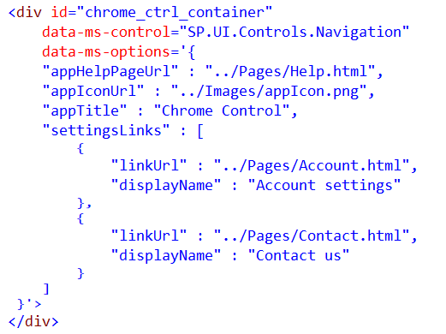
Chrome Control (Declaratively)
Notes:
Create a div tag
Use the attributes data-ms-control and data-ms-options
The chrome control will look for these attributes and render itself in this div

Slide 50
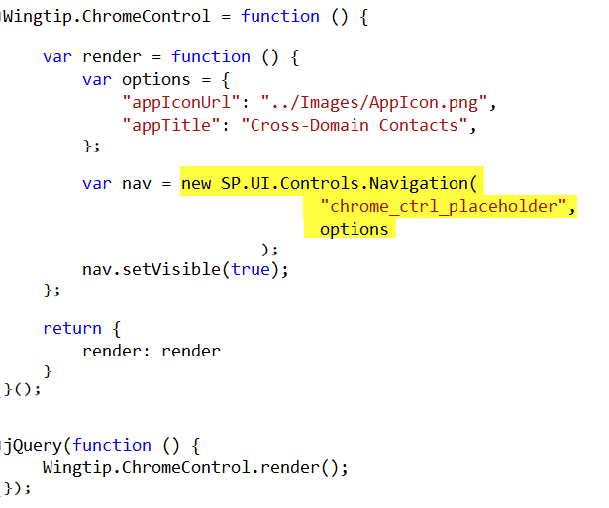
Chrome Control (Programmatically)
Notes:
Here a new chrome control is created in code
When created, it expects you to supply the options and the ID of the div where it should render
Then it renders itself in the div

Slide 51
Remote Event Receivers

Slide 52
Remote Event Handlers
Event Handler code runs in remote (SharePoint) web
Deployed as web service in remote (SharePoint) web
Two-way events
“Before” events (a.k.a, “ING” events)
Synchronous call
Supports a return value
One-way events
“After” events (a.k.a, “ED” events)
Asynchronous call
No return value
Notes:
The event handler infrastructure follows the same pattern as the in-process handlers of old
We have both “before” and “after” event
These are also known as “ING” and “ED” events like “ItemAdding” and “ItemAdded”
Two-way events are synchronous

Slide 53
Supported Events
 | Site | List | List Schema | List Item | App
Create | X | X | X | X
Update |  |  | X | X
Delete | X | X | X | X
Move | X |  |  | X
Check-In |  |  |  | X
Uncheck-In |  |  |  | X
Check-out |  |  |  | X
Attachments |  |  |  | X
File Move/Convert |  |  |  | X
Install |  |  |  |  | X
Uninstall |  |  |  |  | X
Update |  |  |  |  | X

Slide 54
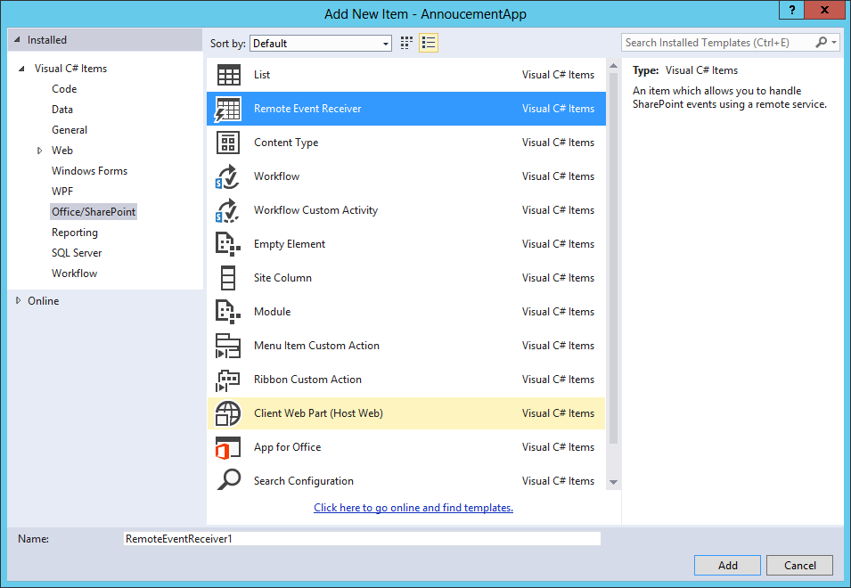
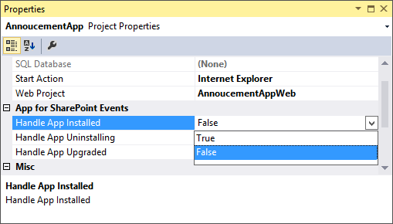
Adding a Remote Event Receiver
Use the “Add New” dialog
For Site, List, Item, and
Schema events
Use the “Properties” dialog
for App events

Slide 55
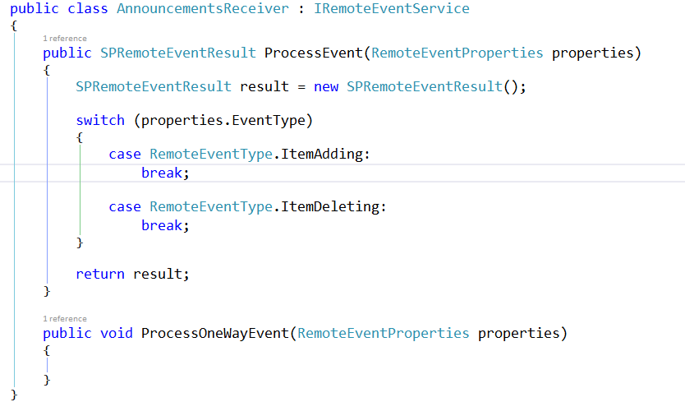
IRemoteEventService
Must be implemented by the remote (SharePoint) web service

Slide 56
SPRemoteEventProperties
Passed to web service in response to event
Provides contextual information
Supports reading and updating user inputs
Allows for data validation

Slide 57
SPRemoteEventResult
Returns by two-way events
Allows events to be cancelled
Allows status to be returned

Slide 58
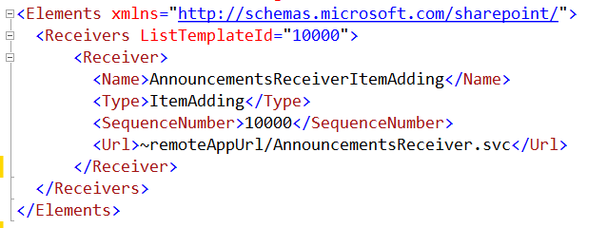
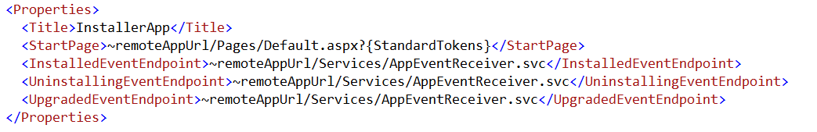
Registering Events Receivers
CAML Element for Lists, Items, Sites, Schema events
App Manifest for
App events

Slide 59
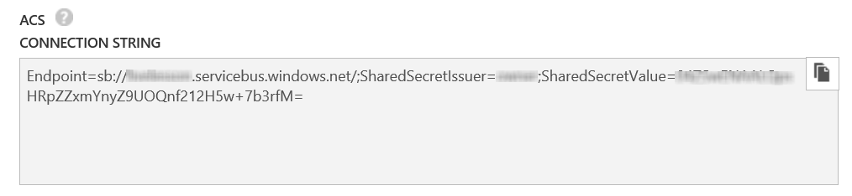
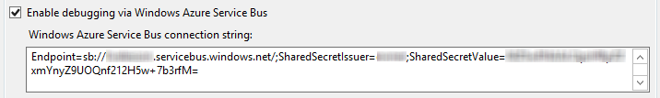
Debugging Considerations
Remote Event Receivers might require Azure Service Bus to support debugging
Create a Service Bus Namespace
Copy the Connection String into the SharePoint Project Properties
Notes:
Note that as of this writing, the Visual tooling only supports ACS strings
The Azure interface only creates SAS strings
So, you have to use PowerShell
Download and Install Azure PowerShell environment
Open PS window
Add-AzureAccount to sign in
New-AzureSBNamespace –Name “myns” -Location “Central US”
Results in an ACS string copy this to Visual Studio

Slide 60

© 2012 Microsoft Corporation. All rights reserved. Microsoft, Windows, and other product names are or may be registered trademarks and/or trademarks in the U.S. and/or other countries.
The information herein is for informational purposes only and represents the current view of Microsoft Corporation as of the date of this presentation. Because Microsoft must respond to changing market conditions, it should not be interpreted to be a commitment on the part of Microsoft, and Microsoft cannot guarantee the accuracy of any information provided after the date of this presentation. MICROSOFT MAKES NO WARRANTIES, EXPRESS, IMPLIED OR STATUTORY, AS TO THE INFORMATION IN THIS PRESENTATION.

Slide 61
© 2012 Microsoft Corporation. All rights reserved. Microsoft, Windows, and other product names are or may be registered trademarks and/or trademarks in the U.S. and/or other countries.
The information herein is for informational purposes only and represents the current view of Microsoft Corporation as of the date of this presentation. Because Microsoft must respond to changing market conditions, it should not be interpreted to be a commitment on the part of Microsoft, and Microsoft cannot guarantee the accuracy of any information provided after the date of this presentation. MICROSOFT MAKES NO WARRANTIES, EXPRESS, IMPLIED OR STATUTORY, AS TO THE INFORMATION IN THIS PRESENTATION.

